Slide 1
Wind Turbines

Slide 2
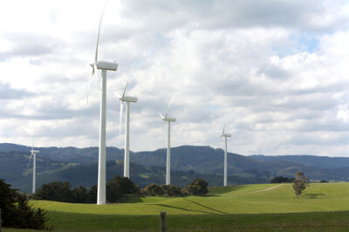
By the end of this lesson on wind turbines you should be able to do the following:
Explain what a wind farm is.
Describe the purpose of a rotor.
Describe the purpose of a nacelle.

Slide 3
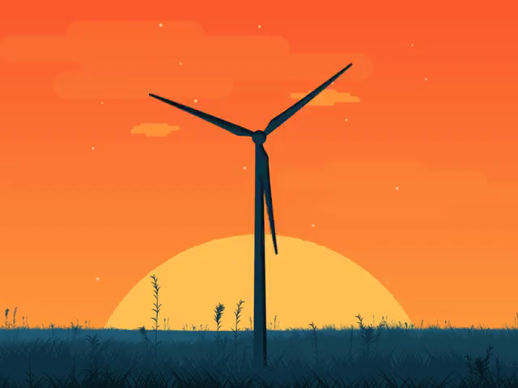
These days you will mainly see a type of windmill called a wind turbine.
Wind energy generates no greenhouse gas emissions.

Slide 4
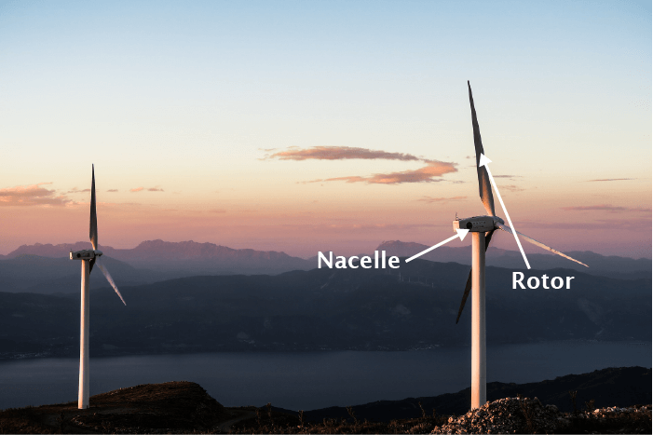
Wind turbines take the power of the wind and convert it into electricity - some of the power in your home might come from wind turbines!
They are made up of rotors (fan blades) and a nacelle (the electrical box), suspended in the air on a tall tower.

Slide 5
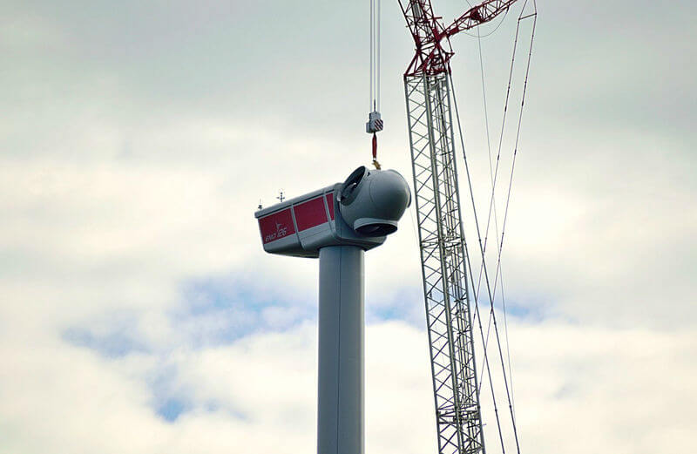
Inside the nacelle is a generator which is able to turn the movement of the rotors into electricity.
Nacelles are built with limitations to stop the machines from being damaged.

Slide 6
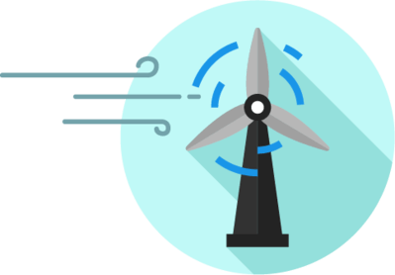
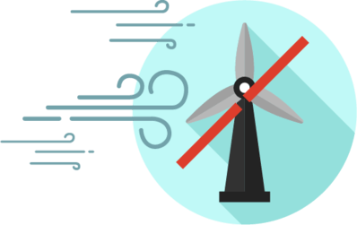
A wind turbine's limitations involve wind speed.
The generator can only make electricity at wind speeds above 14 km/h because that's when the rotors can start moving.
When the wind speed is over 90 km/h it has the potential to damage the rotors, so the nacelle shuts them down.

Slide 7
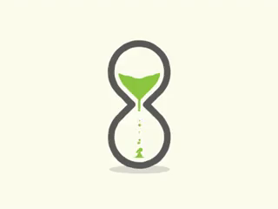
Wind farms (large groups of wind turbines) are very expensive to set up.
This means that they need to be put in an area where they can operate more than 90% of the time to get the most use out of them.
If they are operating less than 90% of the time, the costs involved in running them are too much.

Slide 8
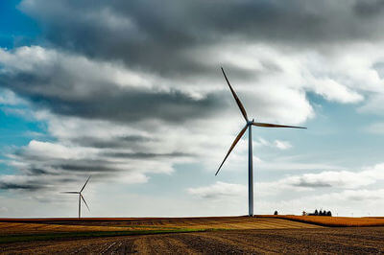
Because efficiency is so important for a wind farm, potential sites have strict criteria to meet.
A wind atlas is needed. This contains averages of wind speed, height and direction over short and long periods of time.
Local, detailed wind maps are created by closely monitoring site data for a year or more.

Slide 9
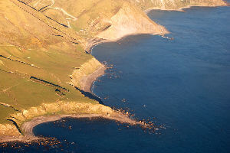
Southern and Southwestern Australia are good sites for wind farms.
This is because the wind can get very strong over thousands of kilometres of desert, and lots of electricity can be generated.

Slide 10
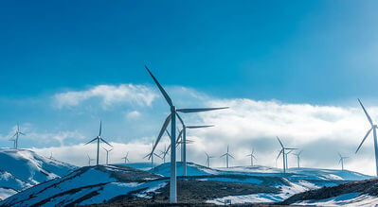
Onshore and offshore winds also create convection cells.
These are quite fast and can be used by wind farms.

